Slide 1



“ERRA : An Artificial Companion”
BY
Alister Fernandes
Atharva Shewale
Ekta Bhushan
Rucha Khartadkar

Slide 2

PROBLEM STATEMENT:
TO BUILD UP AN AUTOMATED VIRTUAL PERSONAL ASSISTANT APPLICATION “ERAA” THAT WILL HELP THE CLIENT WITH REGULAR UNDERTAKING OF DIFFERENT OPERATIONS AND FEATURES BY VOICE ACKNOWLEDGMENT WITH HIGH ACCURACY.

Slide 3
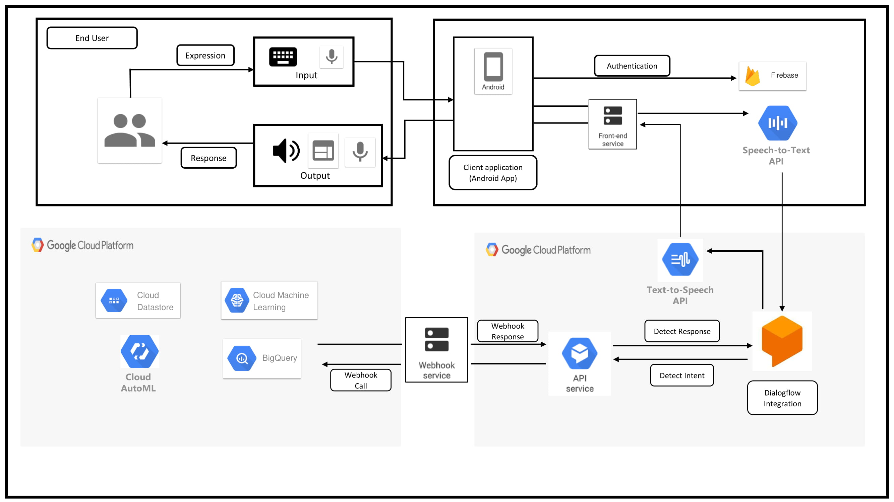
SYSTEM DESIGN:

Slide 4
CHALLENGES OF EXISTING SYSTEM:
DIFFICULTIES OF EXISTING FRAMEWORK IS THAT IT NEED NON-STOP ASSOCIATION OF INTERNET.
THE ACCURACY OF LISTENING OF DIFFERENT ASSISTANTS TO USERS COMMAND IS NOT VERY EFFICIENT.
PURPOSE OF PROPOSED SYSTEM:
TO IMPLEMENT MACHINE LEARNING MODULES TO PREDICT THE INPUT DATA AND GIVE THE RESULTS OF THE PREDICTED DATA INTO A STANDARD OUTPUT, ALSO USING NLP ALGORITHMS TO INCREASE PRODUCTIVE EXACTNESS OF LISTING TO USERS COMMAND.

Slide 5
OBJECTIVES OF THE PROPOSED SYSTEM:
TO ARCHITECT AN INFORMATION STORE THAT IS OPTIMALLY DESIGNED TO ANSWER QUERIES, AND ACCURATELY ANSWER QUESTIONS POSED TO IT. FOR VOICE TO TEXT, AND TEXT TO VOICE AND BY USING STANDARD (FREE) LIBRARIES/SERVICES AVAILABLE IN THE MARKET.
SCOPE AND GOAL OF THE PROPOSED SYSTEM:
INTELLIGENT VIRTUAL ASSISTANTS ARE VERY IMPORTANT PART OF TODAY’S LIFE IF WE HAVE SMARTPHONES. WHETHER, TO CALL A NUMBER, MESSAGE ANYONE, CHECKING WEATHER OR TRAFFIC STATUS, IT CAN JUST HAPPEN IN A FEW SECONDS BY GIVING VERBAL COMMANDS WITH EFFICIENCY.
THERE IS A LARGE PORTION OF PEOPLE FROM DISABLED COMMUNITY MOSTLY WITH COGNITIVE DISABILITIES WHO MAY HAVE HARD TIME IN FORMING FULL SENTENCES AND COMMUNICATION, FOR SUCH PEOPLE PERSONAL ASSISTANT CAN BE A DEAL BREAKER.

Slide 6
TECHNOLOGIES/ SOFTWARES/ LANGUAGES USED:
GOOGLE CLOUD PLATFORM
GOOGLE DIALOGFLOW
ANDROID STUDIO
JAVA/ FLUTTER

Slide 7
EXPECTED OUTPUT TO BE ACHIEVED:
INTERACT WITH THE ANDROID APPLICATION USING VOICE/ TEXT INPUT.
USER WILL BE ABLE TO PERFORM OPERATIONS JUST LIKE THE EXISTING ASSISTANTS i.e OPEN AN APPLICATION ON THE DEVICE, READ THROUGH THE UPCOMING SCHEDULES, ASKING FOR ADVICE, ETC.
HAVE AN EXPERIENCE OF THE MACHINE LEARNING FEATURES IMPLEMENTED LIKE OBJECT DETECTION, TEXT RECOGNITION, etc.
DOCUMENTIONS TO BE PROVIDED IN A WAY WHICH WILL HELP A USER UNDERSTAND THE OVERALL WORKING AND DESIGN OF THE APP, WHICH IN TURN CAN HELP THEM TWEAK IT AS PER THEIR KNOWLEDGE AND CONVENIENCE.
PROVIDE A UI WHICH WILL ATTRACT USERS IN USING THE APPLICATION AS MANY TIMES NEEDED.

Slide 8
APPLICATIONS OF THE PROPOSED SYSTEM:
VIRTUAL ASSISTANT REDUCE THE LABOR COST AND COST OF OPERATION AND THEY DO NOT REQUIRE ANY RENT OR UTILITIES. THUS, IT RESULTS IN SAVING MONEY.
WITH A VIRTUAL ASSISTANT, YOU DON'T HAVE TO RECRUIT SOME OTHER REPRESENTATIVE TO MIND YOUR WORK IN THE BUSINESS HOURS. YOU CAN WORK WHENEVER YOU NEED AND WORKING IS POSSIBLE EVEN OUTSIDE BUSINESS HOURS.
VIRTUAL ASSISTANTS RESULT IN INCREASE IN PRODUCTIVITY. YOU DO NOT NEED TO TRAIN VIRTUAL ASSISTANT. THEY ARE PRE- PROGRAMMED AND ALREADY TRAINED ENOUGH TO ASSIST YOU IN ANY CONDITIONS LIKE THE ALL TIME TRACKING SYSTEM (WITH LEARNING ALGORITHMS IF INVOLVED).
VIRTUAL ASSISTANTS ARE MORE EFFICIENT. VIRTUAL ASSISTANT KEEPS YOUR PROJECT AND TASK ON SCHEDULE AND THERE IS NO OVERTIME FOR A VIRTUAL ASSISTANT.

Slide 9
CONCLUSION:
In a step aimed to put a limelight on the different advantages and use-cases of artificial intelligence, we are building this system which will help users in getting their work done efficiently and make them know how artificial intelligence can help enhance the work life of a human.

